Slide 1
Reinforcement learning for dynamics & control

Slide 2
Model-Based Reinforcement Learning
Dyna-Style Algorithms
Policy Search with Backpropagation through Time
Shooting Algorithms
Dyna- style Algorithm
Model-Ensemble Trust-Region Policy Optimization (ME-TRPO)(Berkeley AI Research 2019)
Stochastic Lower Bound Optimization (SLBO) (Facebook AI Research 2021)
Model-Based Policy-Optimzation (MBPO) (Berkeley AI Research 2019)

Slide 3
MODEL-ENSEMBLE TRUST-REGION POLICY OPTIMIZATION (ME-TRPO)

Slide 4
Layout

Slide 5
Video of training
https://www.youtube.com/watch?v=pgaEE27nsQw
IIsc robot lEg video

Slide 6
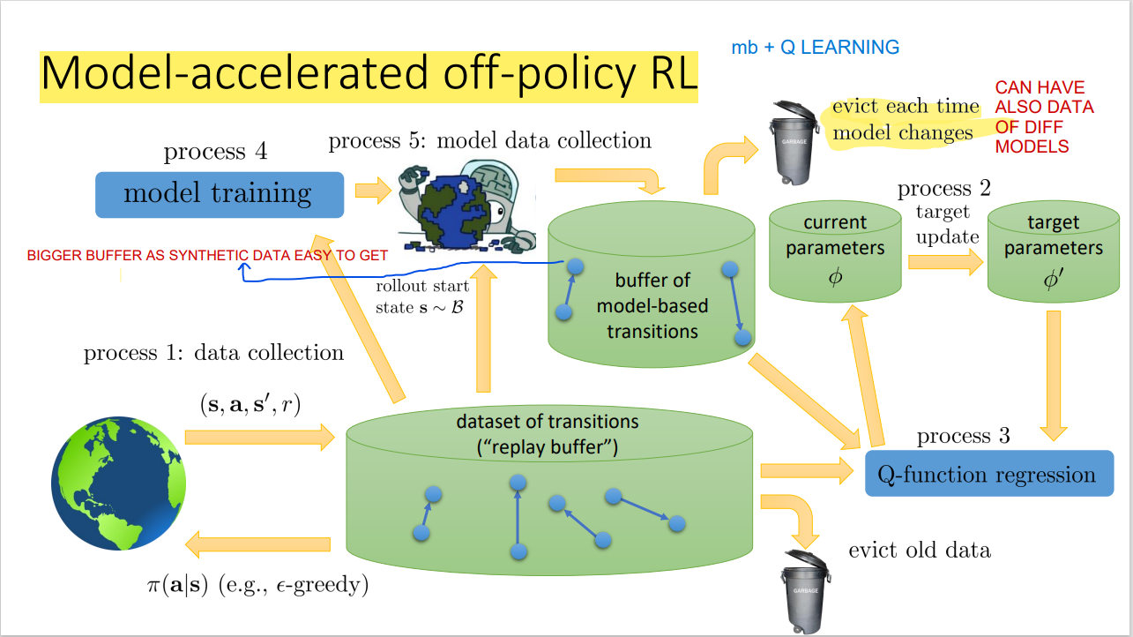

Slide 7

Problem
Control of a lower limb exoskeleton having contact with ground using RL

Slide 8
Problem abstract
MBRL is a popular approach for improving sample efficiency in comparison to model-free algorithms. This is achieved by creating a predictive model of the environment. However, the effectiveness of MBRL largely depends on the accuracy of the learned model.
Unfortunately, this model is usually built in a black-box manner and may not be reliable outside of the data distribution(OOD), leading to poor predictive accuracy. As a result, the learned model may not be suitable for policy optimization.
To address this challenge, we propose to use prior knowledge of the known system and its environment. This approach would allow us to incorporate this prior knowledge into the learning process and potentially improve the accuracy and sample efficiency of the learned model.

Slide 9
Reference
Wang, T., Bao, X., Clavera, I., Hoang, J., Wen, Y., Langlois, E., Zhang, S., Zhang, G., Abbeel, P., & Ba, J. (2019, July 3). Benchmarking model-based reinforcement learning. arXiv.org. Retrieved March 18, 2023, from https://arxiv.org/abs/1907.02057
Kurutach, T., Clavera, I., Duan, Y., Tamar, A., & Abbeel, P. (2018, October 5). Model-Ensemble Trust-Region Policy Optimization. arXiv.org. Retrieved March 18, 2023, from https://arxiv.org/abs/1802.10592
Trust region policy optimization - arxiv. (n.d.). Retrieved March 17, 2023, from https://arxiv.org/pdf/1502.05477v5.pdf

Slide 10
Queries

